Slide 1
Accessing the environments &
Getting started with the Labs

Slide 2
About the virtual event resources
You will use separate, but identical virtual environments (VM images) running in cloud
You will use your IBM ID to you to access your environment
Access to environment desktop is through web browser (Chrome and Firefox recommended)
Lab instructions and all presentations are in a BOX-folder, links provided (read and download) and accessible directly from your laptop / other computer or from your virtual environment
Each VM has a link to lab resources BOX-folder to download all the needed lab resources to the VM
IBM RPA is installed locally to your VM (on-prem installation)→ can not use IVAs 😞

Slide 3
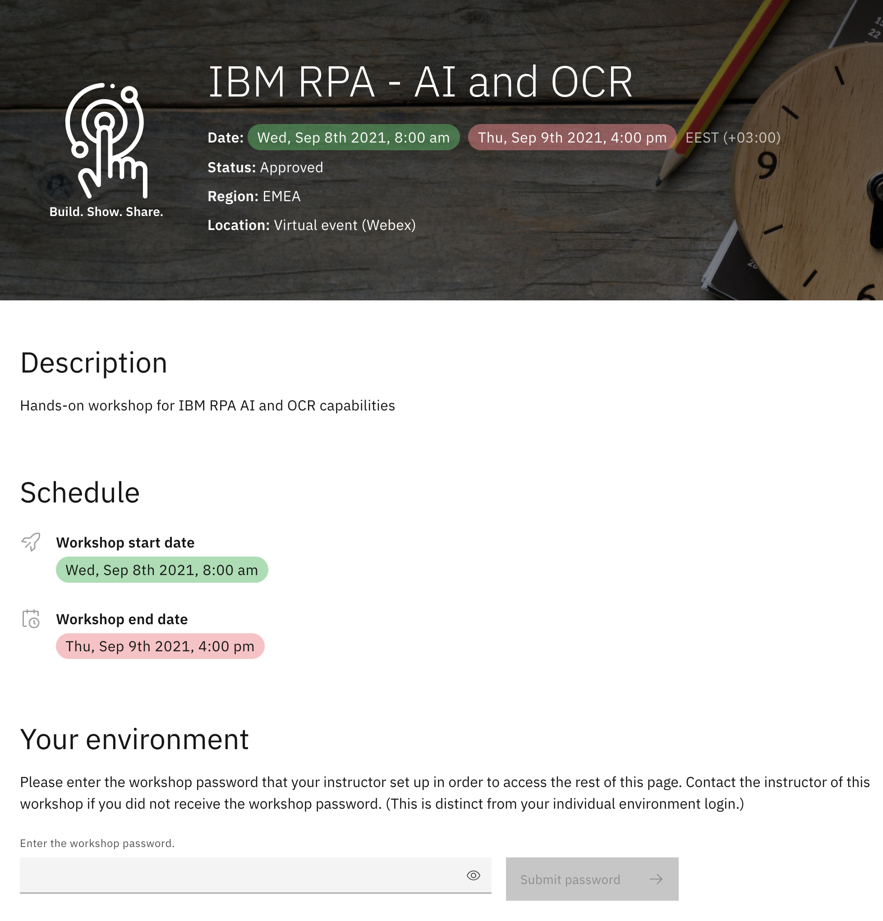
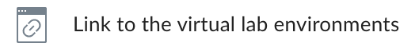
Accessing your virtual environment (1)
Go to RPA Bot Design and Reporting
Click on
Click on Continue to leave Box
Log in with your IBM ID if not already logged in
On Welcome to your workshop page
Enter rpa4ever as workshop password
Click on Submit password
Free environment will be automatically assigned to you
Notes:
https://conf.bluedemos.com/app/home/session/3466/FD60BYYOYMF95G10MYZWMWmqfd292lklp7zt8p1jghgjYRGGOTV8VUHTP209HJQE

Slide 4
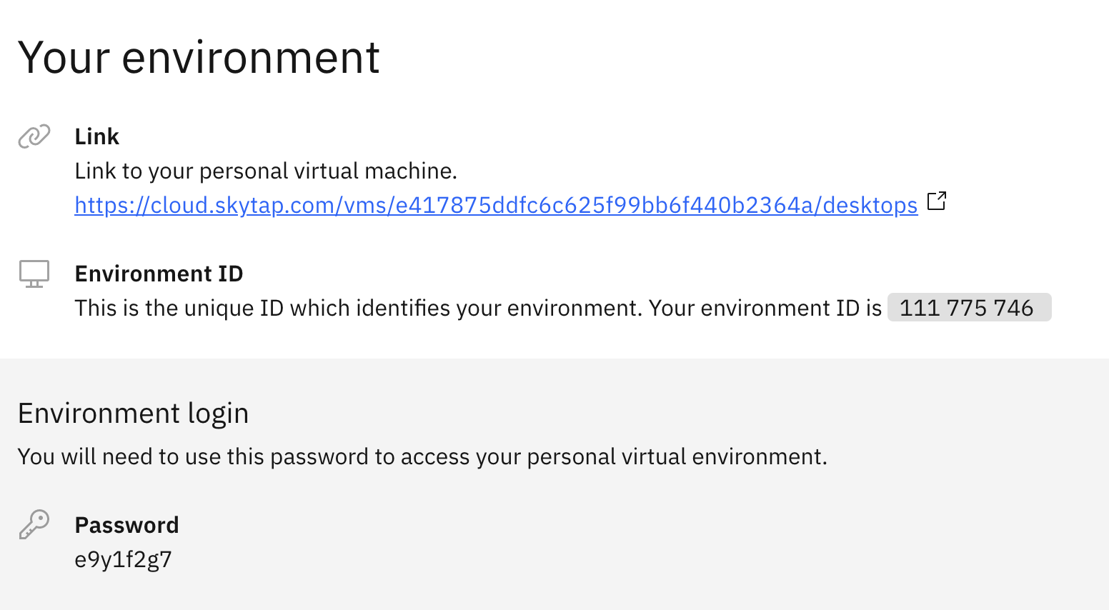
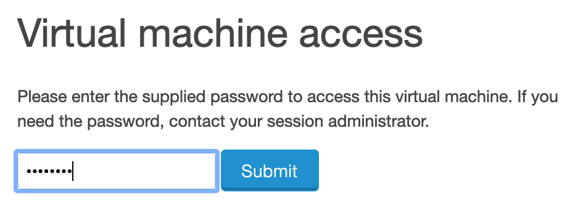
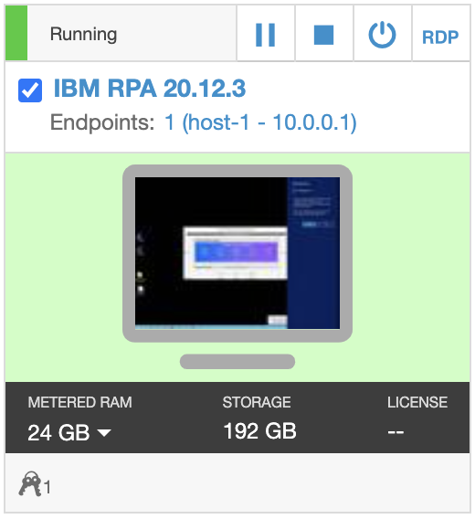
Accessing your virtual environment (2)
Copy the password to your clipboard
Click the Link to your personal virtual machine
Paste the password to password field and click Submit
You should see your environment already running
Click the display image to access your environments virtual desktop (opens in new browser tab)
Notes:
https://conf.bluedemos.com/app/home/session/3466/FD60BYYOYMF95G10MYZWMWmqfd292lklp7zt8p1jghgjYRGGOTV8VUHTP209HJQE

Slide 5
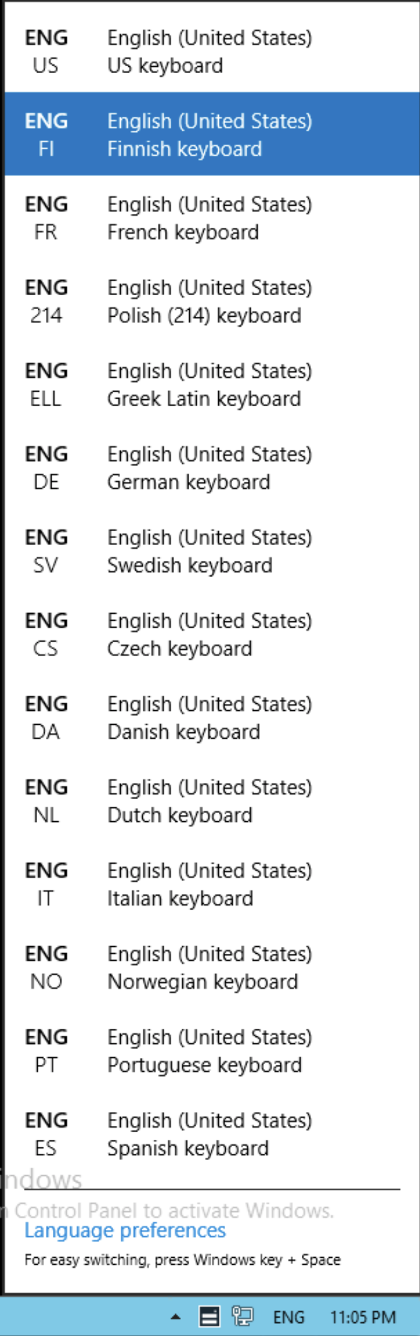

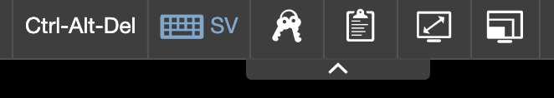

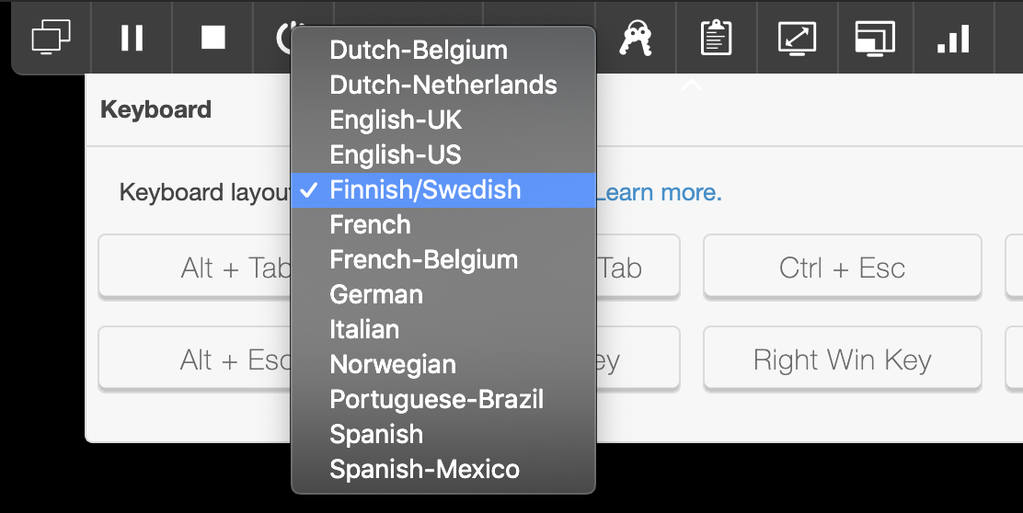
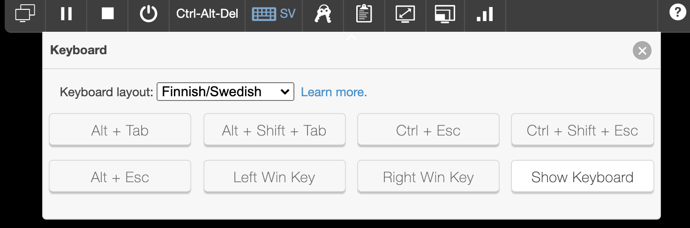
Setting up your virtual desktop
Maximize your browser and optimize your screen by clicking on virtual desktop toolbar
Setting the keyboard layout
Click the virtual desktop toolbar keyboard icon to select your keyboard language (NOTE! If you do not find your keyboard, select English-US)
To avoid any issues, make sure that your virtual image OS keyboard setting matches your selection!
If you do not find your match (use English-US), you can use the virtual keyboard to insert special characters when needed

Slide 6
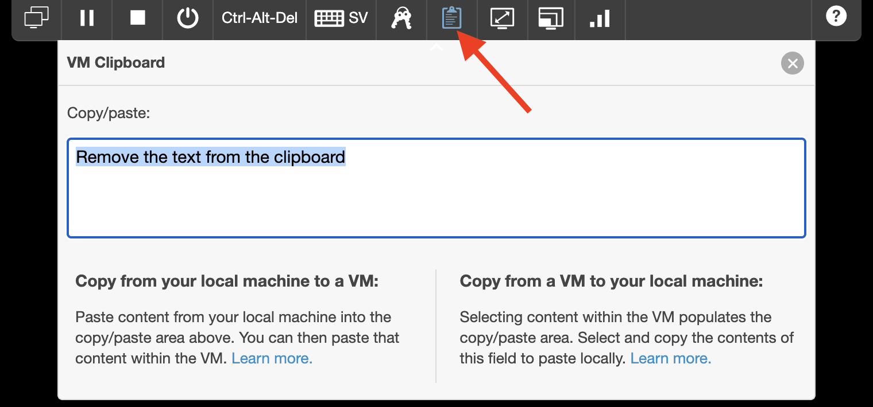
Issue: Copy – Paste with keyboard shortcuts (Ctrl+c / Ctrl+v)
We have seen quite a few issues when using keyboard shortcuts for copy – paste
When using keyboard shortcuts, they might “lock” your virtual desktop’s clipboard
If that happens, open your virtual desktop’s clipboard and remove the text you might have there and – VERY IMPORTANT – use mouse right-click → copy and paste with mouse right-click ONLY!!

Slide 7
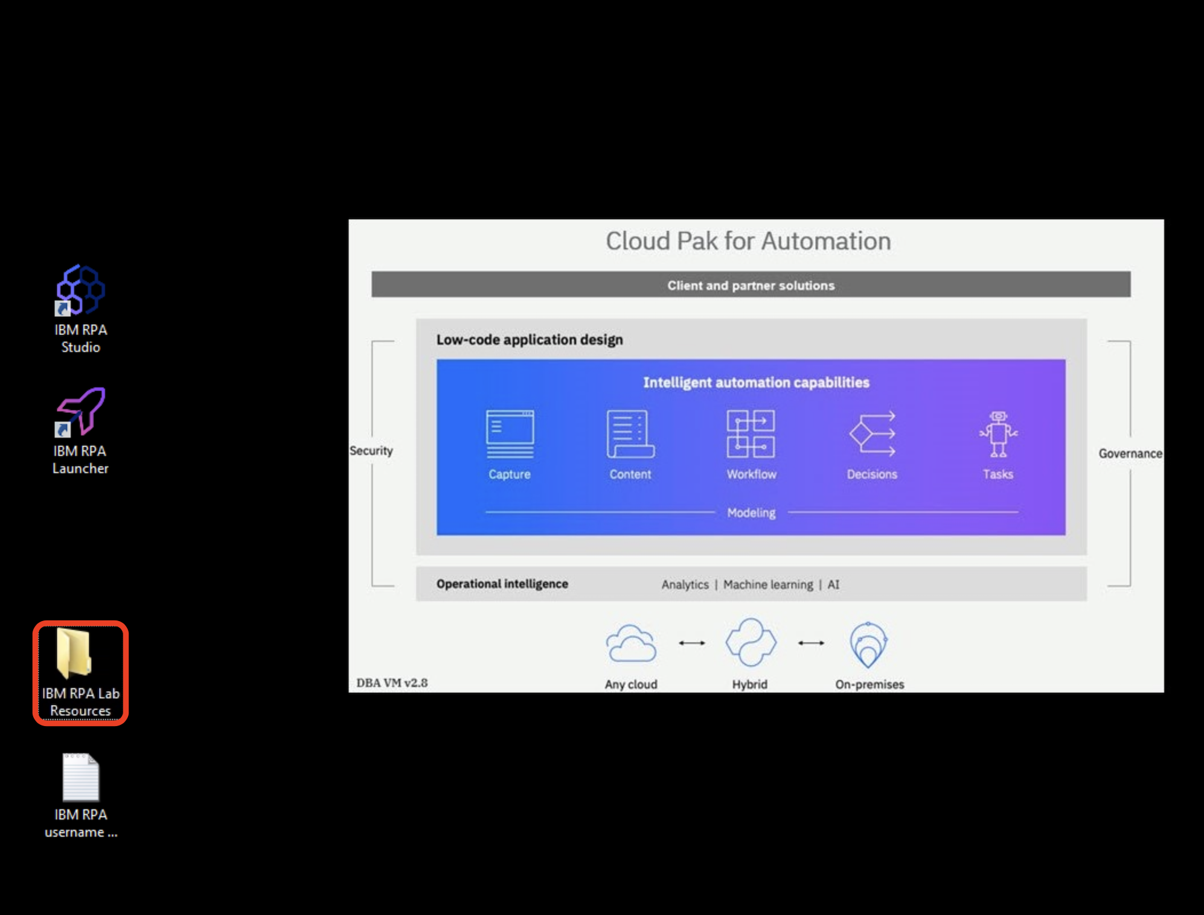
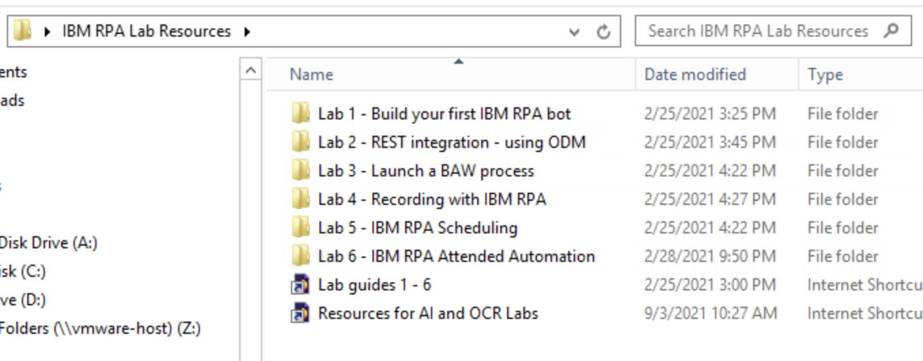
Getting started with the labs
Open the lab guides RPA Bot Design and Reporting
Accessible also from your personal device (second screen)
Open the IBM RPA Lab Resources folder at your virtual desktop
Copy and paste the contents of the box folder to your IBM RPA Lab Resources folder

